Slide 1
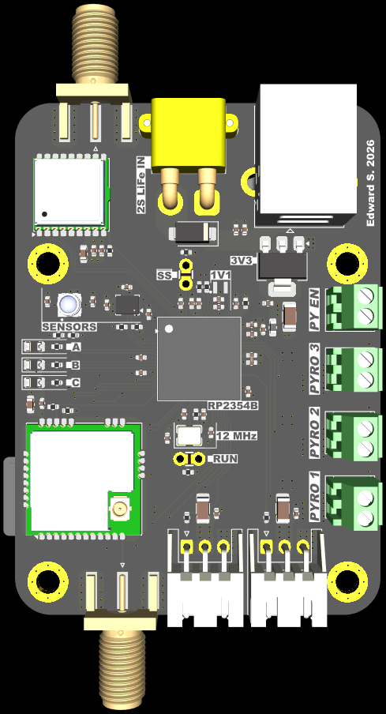
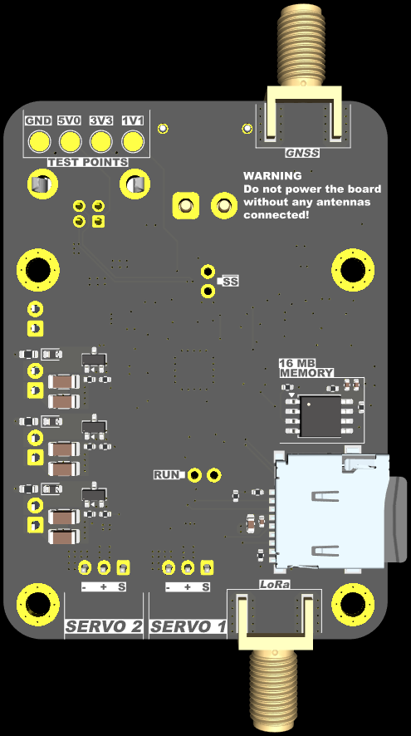
Front
Rear
GNSS antenna SMA-F
XT30 battery input
Test points
USB-B Female
MAX-M10S GNSS
~SS jumper (BOOTSEL)
ORing diode
AMS1117 3.3 V LDO + Heatsink
LSM6DSV32X IMU
BMP585 barometer
Pyro arming switch
RP2354B
Debug/status LEDs
Pyro 3
12 MHz crystal
16MB NOR flash
Pyro 2
Pyro circuitry ×3
RAK3172 LoRa
RUN jumper
Pyro 1
microSD
Servo 1
Servo 2
LoRa antenna SMA-F

